Slide 1
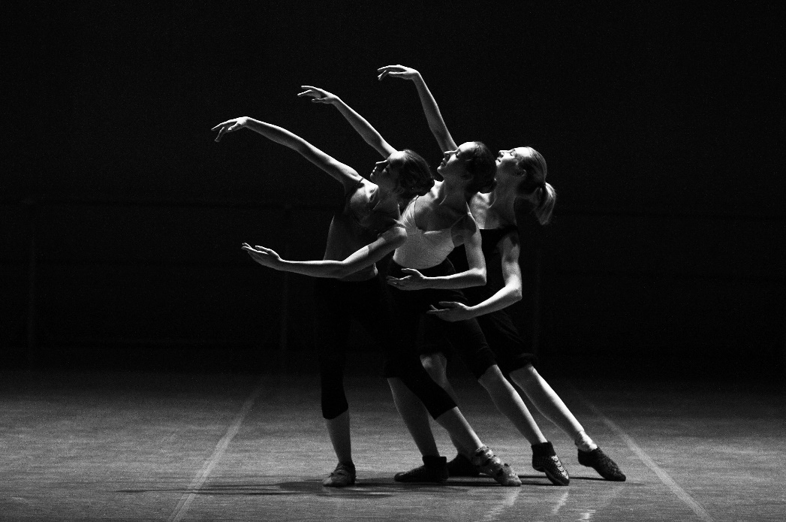
Concurrent Interpretations of Authorization Logic
Andrew K. Hirsch
Boston Computing Club
March 13 2021

Slide 2
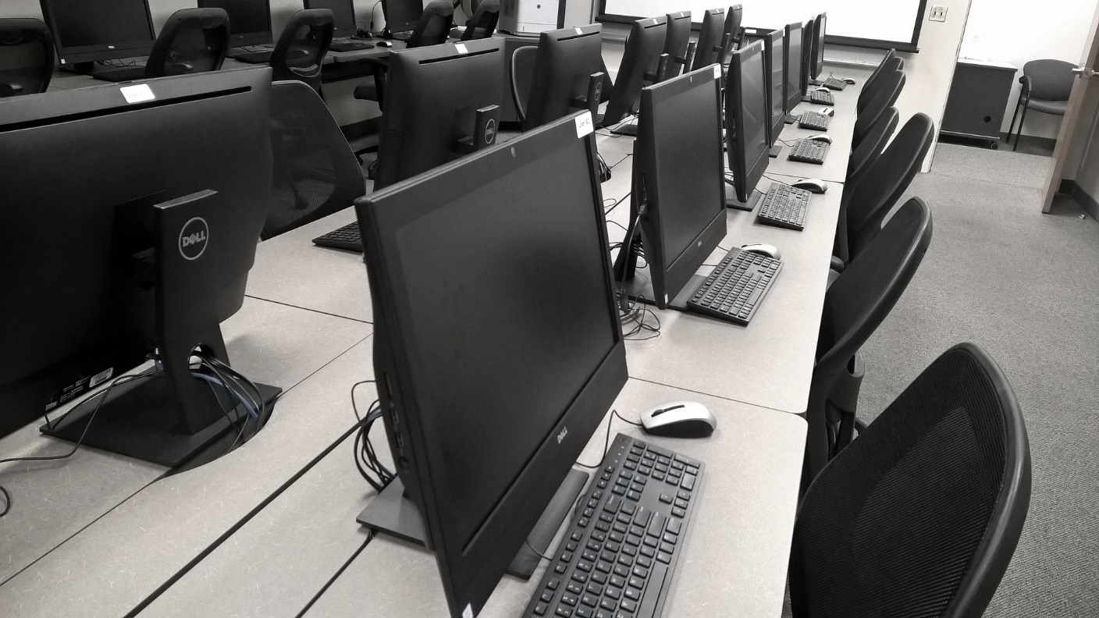
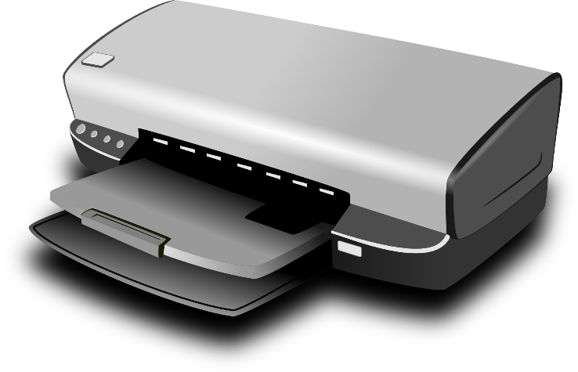
Is Alice a UdS student?
Is Alice allowed to print?
Alice is a UdS Student
I want to print a document
Policy:
UdS Students may print
Alice is a UdS Student

Slide 3
Who is who?
Questions about authorization:
How do we state authorization policies?
How do we reason about authorization policies?
How do we enforce authorization policies?
thentication
Main focus of today’s talk
Touch on if time
Who may do what?
thorization
What do we record?
dit

Slide 4
Principals System Components
Users
Software Modules
Machines
Permissions
Alice may print
Policies
Beliefs
Policy:
UdS Students may print
Alice is a UdS Student
Wrong Beliefs
Compromised

Slide 5
Does this policy subsume that?
Under what circumstances may Alice e.g., print?
Why is something (not) allowed?
Need a formal way to write down policies
Logical Implications
“Any principal which is a UdS Student may print.”
Policy:
UdS Students may print
$$∀p :\text{Prin}, \\ \text{isStudent}\left(p\right) \\ → \text{MayPrint}(p)$$
Not all relations are permissions
Permissions are relations

Slide 6
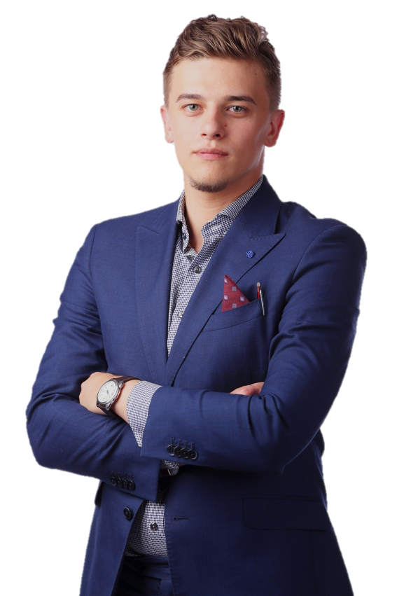
Need to represent trust
Printer says isStudent(Alice)
Need to represent principals’ beliefs
Printer says
UdS speaks for Printer
Alice is a UdS Student
UdS says isStudent(Alice)
$$\text{Bob} \text{says} \\ ¬\text{isStudent}\text{(}\text{Alice}\text{)}$$

Slide 7
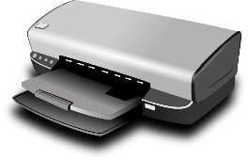
Q: May Alice print?
Assuming things on the left are true, prove the thing on the right
Policy:
UdS Students may print
$$⊢$$
MayPrint(Alice)
$$,$$
May Alice print under this policy?
May Alice print in this model and under this policy?
System Model
$$∀p :\text{Prin}, \\ \text{isStudent}\left(p\right) \\ → \text{MayPrint}(p)$$

Slide 8
$$¬\text{isStudent}\text{(}\text{Alice}\text{)}$$
MayPrint(Alice)
Policy:
UdS Students may print
$$⊢$$
$$,$$
$$,$$
Noninterference
“Only those you trust can hurt you”
Main security theorem for authorization logic
$$¬\text{isStudent}\text{(}\text{Alice}\text{)}$$
Policy:
UdS Students may print
$$⊬$$
Speaks For
$$,$$
$$,$$

Slide 9
If everything up here is true
A
B
D
E
$$Γ$$
$$⊢$$
$$φ$$
Logical Formula
Then so is everything down here
Set of Logical Formulae
Need rules for proofs

Slide 10
$$\frac{φ∈Γ}{Γ⊢φ}$$
$$\frac{Γ, φ, ψ⊢χ}{Γ, φ \& ψ⊢χ}$$
$$\frac{Γ⊢φ Γ⊢ψ}{Γ⊢φ \& ψ}$$
&-L
You can use an assumption of $φ\&ψ$ by using an assumption of $φ$ and an assumption of $ψ$
&-R
You can prove $φ\& ψ$ by proving $φ$ and $ψ$
axiom
You can prove $φ$ by assuming it

Slide 11
$$\frac{φ∈Γ}{Γ⊢φ}$$
$$\frac{Γ, φ, ψ⊢χ}{Γ, φ \& ψ⊢χ}$$
$$\frac{Γ⊢φ Γ⊢ψ}{Γ⊢φ \& ψ}$$
axiom
&-L
&-R
$$ψ∈φ, ψ$$
$$φ∈φ, ψ$$
axiom
axiom
$$φ, ψ⊢ψ$$
$$φ, ψ⊢φ$$
&-R
$$φ, ψ⊢ψ \& φ$$
&-L
$$φ \& ψ⊢ψ \& φ$$

Slide 12
$$¬\text{isStudent}\text{(}\text{Alice}\text{)}$$
MayPrint(Alice)
$$⊢$$

Slide 13
Principals are Reasoners
Principals can reason from their beliefs to derive new beliefs
$$φ, ψ, Γ ⊢χ$$
$$φ$$
$$ψ$$
$$Γ$$
$$χ$$
$$⊢$$
$$,$$
$$,$$

Slide 14
Says Reflection
Principals know what they believe.
$$φ$$
$$φ$$
$$⊢$$

Slide 15
Says Join
Principals are right about what they believe.
$$φ$$
$$φ$$
$$⊢$$

Slide 16
Counit does NOT hold
Principals may believe untrue things
$$φ$$
$$φ$$
This rule is common in logics of knowledge, rather than belief
$$⊢$$

Slide 17
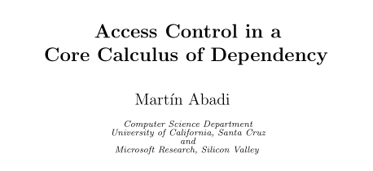
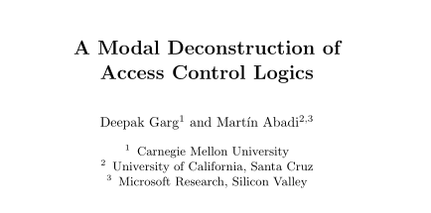
Should Unit Hold?
Principals believe all true things
Yes
No
Extremely Influential
$$φ$$
$$φ$$
$$⊢$$

Slide 18
Confidentiality (2020)
Unit can leak secrets
I owe $100
I owe $100
$$⊢$$
Formal treatment of confidentiality in authorization

Slide 19
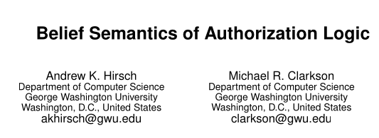
Distribution (2013)
Unit can break distributivity
CPUState(3)
CPUState(3)
$$⊢$$
Argument about distribution made informally

Slide 20
The Propositions-as-Types Principle
Logic | Computation

Slide 21
The Propositions-as-Types Principle
Logic | Computation
Propositions | Types

Slide 22
The Propositions-as-Types Principle
Logic | Computation
Propositions | Types
Proofs | Programs

Slide 23
The Propositions-as-Types Principle
Logic | Computation
Propositions | Types
Proofs | Programs
Assumptions | Inputs

Slide 24
The Propositions-as-Types Principle
Logic | Computation
Propositions | Types
Proofs | Programs
Assumptions | Inputs
Conclusions | Outputs

Slide 25
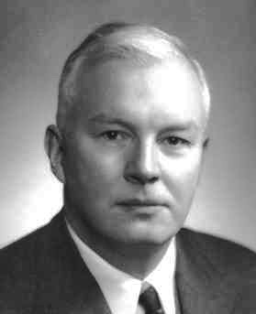
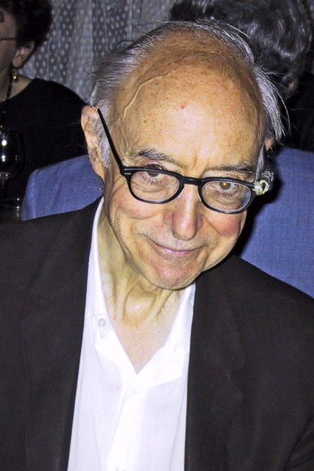
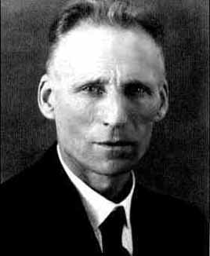
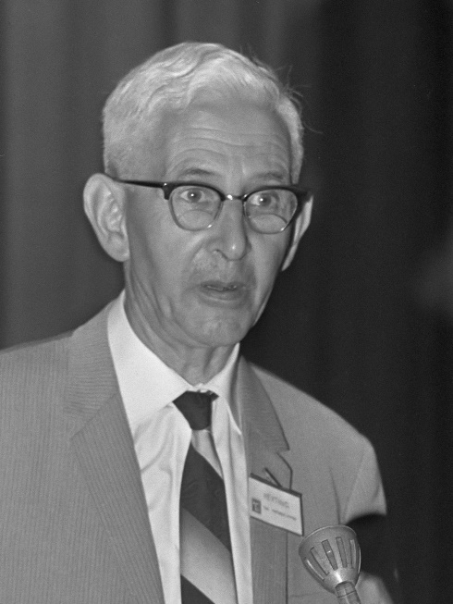
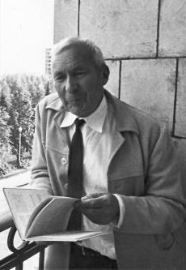
The Curry-Howard Isomorphism
The Curry-Howard Correspondance
Haskell Curry
William Howard
Andrej Kolmogorov
LEJ Brouwer
Arend Heyting
The Brouwer-Heyting-Kolmogorov Interpretation
Picture of William Howard from UIC. All others from Wikimedia Commons.

Slide 26
$$\frac{x : φ∈Γ}{Γ⊢x : φ}$$
Assumptions are variables
var
$$\frac{Γ, x : φ, y : ψ⊢e : χ}{Γ, z : φ \& ψ⊢{\text{let} (x,y) ≔z \text{in} \atop e} :χ}$$
Match
Evidence for $φ\&ψ$ is a pair of evidence for $φ$ and $ψ$
$$\frac{Γ⊢e_{1} : φ Γ⊢e_{2} : ψ}{Γ⊢\left(e_{1},e_{2}\right) :φ \& ψ}$$
Pair

Slide 27
$$y :ψ∈x :φ, y :ψ$$
$$x :φ∈x :φ, y :ψ$$
$$x :φ, y :ψ⊢y : ψ$$
$$x :φ, y :ψ⊢x :φ$$
$$x : φ, y : ψ⊢\left(y,x\right) : ψ \& φ$$
$$φ \& ψ⊢\text{let} \left(x,y\right)≔z \text{in}\left(y,x\right) :ψ \& φ$$

Slide 28
The Propositions-as-Types Principle
Logic | Computation
Propositions | Types
Proofs | Programs
Assumptions | Inputs
Conclusions | Outputs
Principals

Slide 29
The Propositions-as-Types Principle
Logic | Computation
Propositions | Types
Proofs | Programs
Assumptions | Inputs
Conclusions | Outputs
Principals
Trust

Slide 30
The Propositions-as-Types Principle
Logic | Computation
Propositions | Types
Proofs | Programs
Assumptions | Inputs
Conclusions | Outputs
Principals
Trust
Communication

Slide 31
The Propositions-as-Types Principle
Logic | Computation
Propositions | Types
Proofs | Programs
Assumptions | Inputs
Conclusions | Outputs
Principals | Processes (Computers, threads,…)
Trust
Communication

Slide 32
The Propositions-as-Types Principle
Logic | Computation
Propositions | Types
Proofs | Programs
Assumptions | Inputs
Conclusions | Outputs
Principals | Processes (Computers, threads,…)
Trust | Channels
Communication

Slide 33
The Propositions-as-Types Principle
Logic | Computation
Propositions | Types
Proofs | Programs
Assumptions | Inputs
Conclusions | Outputs
Principals | Processes (Computers, threads,…)
Trust | Channels
Communication | Message-Passing

Slide 34
Need a programming paradigm with
Processes
Message-Passing Communication
A Top-Down Point of View
I.e., not a separate program for each process

Slide 35
$$v$$
$$.e$$
$$.v$$

Slide 36
$$;$$
$$.e$$
$$.e′$$
By treating these programs as equivalent, we can reason about concurrency.

Slide 37
$$.e$$
Are Choreographies Good Enough?
Untyped (or Session Typed)
Stateful
No interpretation for common logical connectives (e.g., implication)
No channels
No interpretation for beliefs about beliefs
Receive from Alice
Send $e$ to Bob

Slide 38
Functional Choreographies
Ongoing joint work with Deepak Garg

Slide 39
$$.e$$
$$.x$$
$$;$$
$$.v$$
$$⋮$$
$.x$ now refers to $v$
Whole program computes a value on
$$.e′$$

Slide 40
‘s view of $Γ$
$$Γ⊢e :τ$$
$$Γ⊢$$
$$: .τ$$
$$:?$$
$$.e$$

Slide 41
$.x$ refers to ‘s $e$
$$\text{(}\text{rec} f\left( .x\right). C) e$$
Functions of local values
Can recursively call $f$
Not bound in any process
$$\text{(}\text{rec} f\left(X\right). C_{1}) C_{2}$$
Functions of global values
$X$ refers to $C_{2}$
Can recursively call $f$

Slide 42
$$.x :τ, Γ⊢C :σ$$
$$Γ⊢$$
$$\text{(}\text{rec} f\left( .x\right). C)$$
$$: . τ→σ$$
local

Slide 43
$$\text{(}\text{rec} f\left( .x\right). C) e$$
Are Choreographies Good Enough?
Untyped (or Session Typed)
Stateful
No interpretation for common logical connectives (e.g., implication)
No channels
No interpretation for beliefs about beliefs
‘s view of C
Dummy value
$$\text{(}\text{rec} f\left(x\right). ⟦C⟧ ) e$$
$\text{(}\text{rec} f\left(x\right). ⟦C⟧ )$()

Slide 44
Extending Functional Choreographies
Much more speculative portion of the talk
Ongoing joint work with Hannah Gommerstadt, Alex Kavvos, Daniel Gratzer, Lars Birkedal, and Deepak Garg

Slide 45
speaks for
$$\text{(}\text{rec} f\left(x : ⇒ \right). C)$$
Functions of Channels
Are Choreographies Good Enough?
Untyped (or Session Typed)
Stateful
No interpretation for common logical connectives (e.g., implication)
No channels
No interpretation for beliefs about beliefs
Network Topology
Values as a language parameter
Computes to
$$\text{(}\text{rec} f\left(\right). C_{1}) C_{2}$$
Functions of Principals
Session-Typed Higher-Order Processes
How to compile?

Slide 46
Authorization Logic
Functional Choreographies
$$τ$$
Topology
$$τ$$
Are Choreographies Good Enough?
Untyped (or Session Typed)
Stateful
No interpretation for common logical connectives (e.g., implication)
No channels
No interpretation for beliefs about beliefs
speaks for
Computation
Processes
$$τ$$
$$τ$$
Network Simulation

Slide 47
Distribution
Unit can break distributivity
CPUState(3)
CPUState(3)
$$⊢$$
Need a computation that runs on but doesn’t run on ‘s simulation

Slide 48
Questions about authorization:
How do we state authorization policies?
How do we reason about authorization policies?
How do we enforce authorization policies?
Prove programs follow policies using Propositions-as-types

Slide 49
Write program in typed functional language
Same language
$$⇓$$
Compatible
Write policy as a type
Requires dependent types
Prove your policy, thereby showing that it is followed
Enforcement Neutral

Slide 50
Thank You
Authorization policies can be reasoned about with logic
Rules for this logic are not obvious
Building concurrent interpretations helps us understand what rules are desirable
…and can help us build verification tools as well

